Slide 1
Sentiment Analysis Project
DATA 5100 Group 3 Presentation
Edwin Okwor, Anushka Naidu and Jimmy Nam
Notes:
Speaker Note
This is the final project for group 3 on sentiment Analysis.

Slide 2
Agenda
Introduction
Data Description
Problem
Brief Intro
Research Question
The “why”?
Type of data
Size of dataset
Source and collection
Quality
Processing
Privacy Consideration
Analysis
Results
Conclusion
Type of Problem
Method Used
Statistical Tests
Key Statistics
Potential Expansion
Answer to research question
Limitations

Slide 3
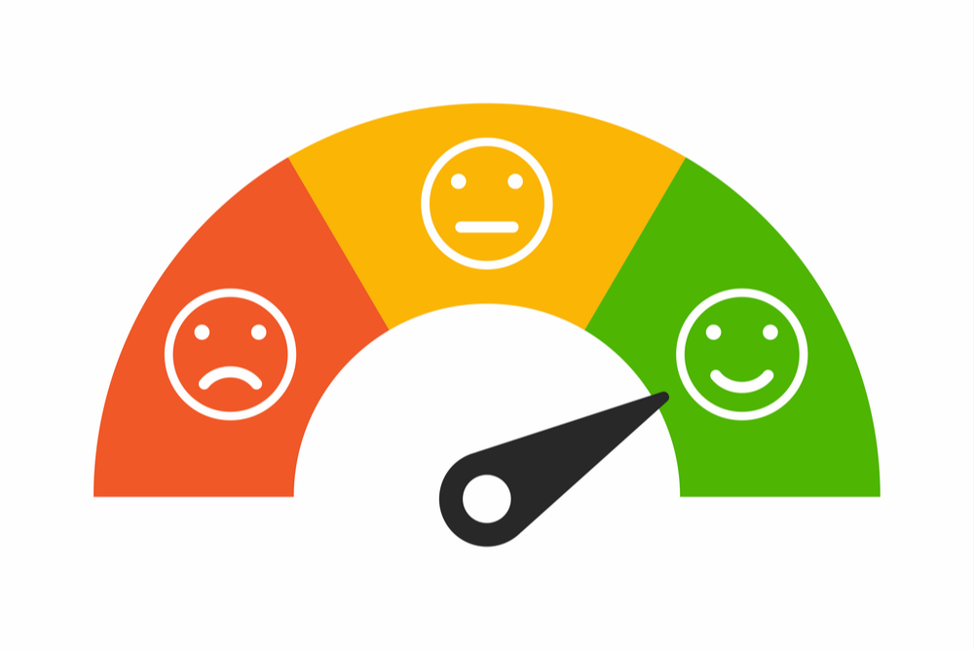
INTRODUCTION
What is Sentiment?
What is Sentiment Analysis?
Notes:
SPEAKER NOTES:
Our project focuses on Sentiment Analysis but we will not be doing a thorough job if we don’t explain what the word Sentiment means. Most know sentiment as the emotion that we attach to things.
As per the Cambridge dictionary,
Sentiment is a thought, opinion, or idea based on feeling about a situation, or a way of thinking about something.
According to Amazon Web Services Webpage, Sentiment Analysis is the process of analyzing digital text to determine if the emotional tone of the message is positive, neutral, or negative.
In today’s world given the large amount of emails or comments on social media posts that one has to work with, Sentiment Analysis tools can help scan a text and automatically determine the author’s attitude toward a topic.
Obtained from: https://itresearches.com/sentiment-analysis/
https://dictionary.cambridge.org/us/dictionary/english/sentiment
https://aws.amazon.com/what-is/sentiment-analysis/

Slide 4
The Problem
Our project focuses on answering:
Can a fine-tuned Transformer model reliably classify social media text into Positive, Neutral, and Negative sentiments?
Is there a statistically significant relationship between sentiment and engagement metrics (likes and retweets)?
Notes:
NOTES:
Today we’re looking at a problem that’s become increasingly important in the world of social media and digital communication: understanding sentiment in online posts.
Social media platforms generate massive amounts of text every second, and organizations often want to understand whether users are expressing positive, negative, or neutral opinions. But manually reading and labeling all of this content isn’t realistic — it requires automated tools that can reliably interpret sentiment
Our project focuses on two main research questions:
First, can a fine-tuned Transformer model — in our case, a DistilBERT model — reliably classify social media text into Positive, Neutral, and Negative sentiment categories? We want to test whether this kind of model can handle noisy, informal, user-generated text and still make accurate predictions.
Second, we investigate whether sentiment has any meaningful relationship with engagement metrics such as likes and retweets. In other words: Do posts with certain sentiments tend to generate more engagement? This helps us understand whether emotional tone influences how people interact with content online.
This problem is important because sentiment analysis is widely used in marketing, public opinion monitoring, customer feedback analysis, and even political forecasting. And knowing whether certain sentiments drive engagement can help creators, companies, and researchers better understand how audiences respond to content.”

Slide 5

Data Description
The dataset was retrieved from Kaggle.
The dataset originally contains 732 records and 15 variables.
Dataset was downloaded and imported into workspace - notebook.
The dataset contains variables of key interest and has a useability score of 10 on Kaggle.
Data has CC0 license Public domain.
Link: https://www.kaggle.com/datasets/kashishparmar02/social-media-sentiments-analysis-dataset.
Notes:
SPEAKER NOTES:
For this project, we used a text-based social media sentiment dataset. The data consists of short social media posts along with their associated sentiment labels.
In regards structure of the the dataset, it contains 732 records and 15 variables, which is an appropriate size for exploratory sentiment analysis and model development on a smaller scale.
The dataset was sourced from Kaggle, created and published by a contributor who compiled publicly accessible social media text. It was downloaded directly from the Kaggle repository and then imported into our analysis notebook. The dataset is licensed under CC0 Public Domain, meaning it is freely available for research and educational use, with no restrictions.
In terms of quality, the dataset has a usability score of 10, indicating that it is well-structured, clean, and includes clearly defined variables. The sentiment labels are standardized, and the dataset contains the key features needed for our project, such as text content, sentiment category, and engagement metrics.
After downloading, we processed the data by cleaning missing values, converting sentiment labels to lowercase, stripping whitespace, and constructing our engagement variable. These preprocessing steps ensured the dataset was ready for both sentiment classification and regression modeling.
Regarding ethics: The dataset contains publicly available social media posts, so informed consent is not documented. Some usernames are visible, meaning the data is not fully anonymized, even though it is released under a CC0 license. To protect privacy, we filtered out all usernames and only used the variables relevant to our analysis.

Slide 6
Data Cleaning & Preparation
Missing/NaNs removed.
Filtering to include only variables of interest.
Sentiment categories cleaned and standardized.
Sentiment labels mapped/grouped for modeling.
Created engagement score (likes + retweets).
Data Split into training/validation/testing.
Notes:
NOTES:
The dataset was first cleaned to ensure quality and consistency. Missing or NaN values were removed to guarantee completeness. We filtered the dataset to retain only variables relevant to the project, including post text, sentiment label, and engagement metrics. Usernames were removed to protect privacy and maintain ethical standards.
Sentiment labels were cleaned and standardized by converting to lowercase and removing extra spaces. Because some original sentiment categories had very few examples, we grouped them into three main classes—positive, negative, and neutral—to create consistent categories suitable for model training.
An engagement score was constructed by summing likes and retweets, which was later used as the dependent variable in regression analysis.
Finally, the data was split into training, validation, and test sets to prepare for model development. The training set was used to fit the model, the validation set to tune hyperparameters, and the test set to evaluate final performance. Splits were stratified by sentiment label to preserve class distribution, using an 70/15/15 proportion for train/validation/test.

Slide 7
Analysis
In this project, we worked with two types of problems:
1. Sentiment Classification (Supervised Learning)
Goal: Predict if a post is Positive, Neutral, or Negative
This is a multi-class classification problem
We trained a machine learning model using labeled examples
2. Engagement Modeling (Regression)
Goal: Determine whether the sentiment of a post helps explain or predict the amount of engagement it receives (likes + retweets).
This is a numerical prediction problem, so we use linear regression to estimate how engagement changes based on sentiment.

Slide 8
Methods
Our methodology included three major components:
Data Preparation
Sentiment Classification Model
Statistical Analysis
This structure allowed us to build a clean dataset, train a reliable model, and evaluate whether sentiment plays a measurable role in engagement patterns.

Slide 9
Exploratory Data Analysis
Before running the regression, we created visualizations to understand early patterns in the data. Our EDA focused on:
Distribution of predicted sentiment categories to see how many posts were classified as Positive, Neutral, or Negative.
Average engagement across sentiment groups to observe whether certain sentiments tended to receive more interactions.
Engagement density curves to examine how engagement values were distributed within each sentiment group and identify where engagement tended to cluster.
These visual patterns helped us identify initial trends and build intuition before statistical modeling. The insights from EDA guided our interpretation of the final regression results.

Slide 10
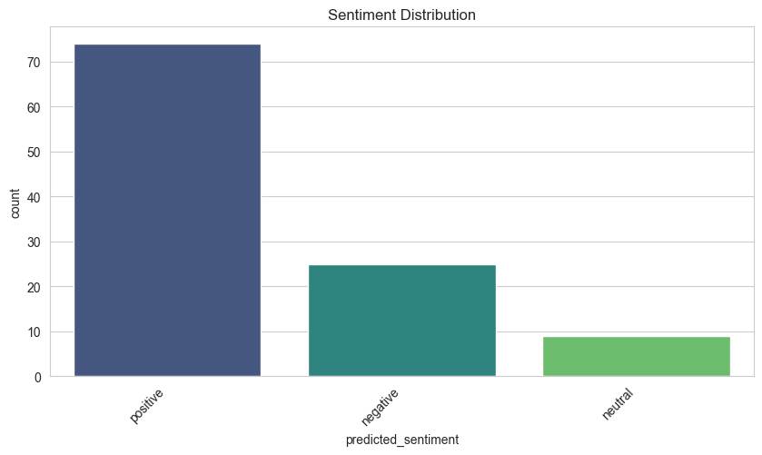
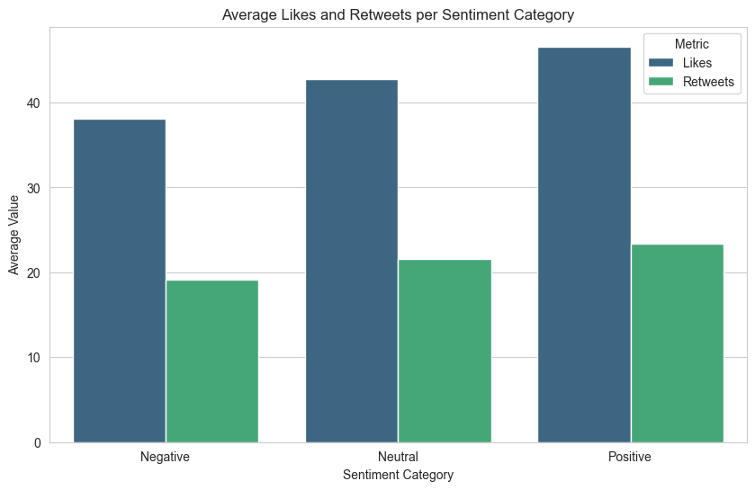
Positive posts show the highest engagement, Neutral posts fall in the middle, and Negative posts receive the least. This suggests that more positive content tends to attract more user interaction.
Positive posts dominate the dataset, while Neutral and especially Negative posts are much fewer. This imbalance led to our use of class weights and stratified splits.
Notes:
Just a draft
What you have is great re: positive posts dominating.

Slide 11
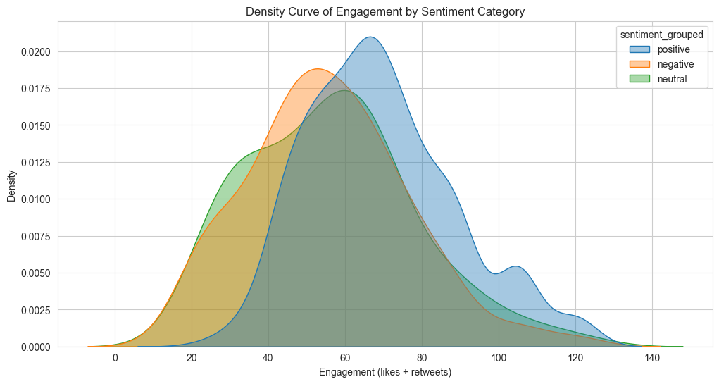
Positive and Neutral posts cluster around higher engagement values, while Negative posts center lower. This pattern supported our expectation that sentiment might predict engagement.

Slide 12
Sentiment Classification Model
To classify sentiment, we fine-tuned a Transformer-based model (DistilBERT)
Tokenized each post into padded and truncated sequences
Added class weights to address class imbalance
Used a three-unit output layer to represent the three sentiment categories
4. Trained the model with:
Learning rate: 2e-5
Batch size: 16
Optimizer: AdamW
Maximum of 6 epochs
5. Used the HuggingFace Trainer API for reproducibility
6. Lastly, we selected the version of the model with the lowest validation loss for final evaluation.
Notes:
For this project, we fine-tuned a DistilBERT transformer model on our cleaned and labeled social-media sentiment dataset.
The model was trained to classify text into three sentiment categories: Negative, Neutral, and Positive.
We used a weighted loss function to address class imbalance since positive comments were over-represented in the dataset.

Slide 13
Regression Model
Engagement Modeling (OLS Regression)
We used linear regression to test whether sentiment predicts engagement (likes + retweets).
Variables:
Y (Dependent): Engagement score
X (Independent): Dummy-coded sentiment
Positive = 1, Negative = 1
Neutral = reference category
Model Form:
Engagement = β0 +β1 (Positive)+β2 (Negative)+ϵ

Slide 14
RESULTS
Notes:
Speaker Notes:
After the analysis, what do the results show us?

Slide 15
Classification Report Summary
Negative
Precision: 1.00
Recall: 0.93
F1-score: 0.96
Support: 27
Neutral
Precision: 0.78
Recall: 0.70
F1-score: 0.74
Support: 10
Positive
Precision: 0.95
Recall: 0.99
F1-score: 0.97
Support: 71
Overall Performance
Accuracy: 0.94
Macro Avg F1: 0.89
Weighted Avg F1: 0.94
Notes:
Speaker Notes – Overall Model Performance
Based on the classification report obtained while validaating our model
Our model achieved an overall accuracy of 94%, showing strong performance across all sentiment classes.
Macro F1-score: 0.89 → shows (relally good ) average performance across classes.
Weighted F1-score: 0.94 → which accounts for class imbalances and overall performance(is also really high)
Key takeaway:
The model is especially strong at identifying positive and negative sentiments.
The neutral class is slightly more challenging, which is expected due to ambiguity in neutral text category.

Slide 16
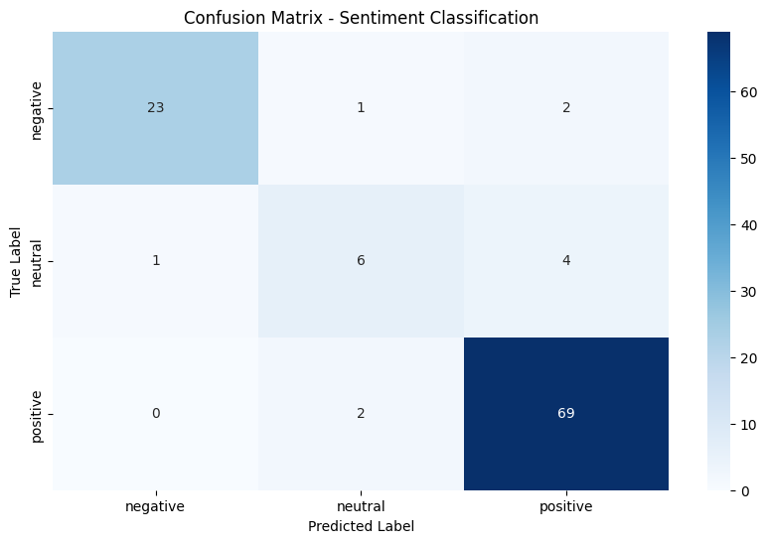
Results - Confusion Matrix
Positive Sentiments: 69/71 correctly classified.
Negative sentiments: 23/26 correctly classified.
Neutral sentiments: 6/11 correctly classified.
Notes:
SPEAKER NOTES:
To understand where exactly the model performs well and where it struggles, we created a confusion matrix. ..Looking at the diagonal values, we see that the model performs extremly well on positive and negative sentiments. As we can see
For the Negatives: 23 out of 26 classified correctly
And for the Positives: 69 out of 71 classified correctly
The main challenge is with the neutral class((with 6 out of 11 classified correctly), likely due to its smaller size in the dataset and the difficulty of distinguishing neutral sentiments from both positive and negative ones. Despite this, the model demonstrates strong overall performance in accurately classifying sentiments.

Slide 17
Prediction - Test Accuracy Calculation
Compared the true sentiment labels with the predicted labels on the test dataset only.
Counted the number of correct predictions using a direct equality check between actual and predicted labels.
Computed test accuracy using the formula: Accuracy = Correct Predictions / Total Samples
Correct Predictions: 102
Total Samples: 108
Test Accuracy: 0.94 (94%), indicating strong generalization performance on unseen data.
Notes:
Speaker Notes – Model Evaluation
We also further evaluated model quality using a held-out test set (which was 15% of the total dataset).
And Compared predicted labels to true labels:
Correct predictions: 102 out of 108
Test accuracy: 0.94
This shows the model generalizes well and performs reliably on unseen data.

Slide 18
Regression Analysis
Key Findings
Model Significance: The overall model is statistically significant. (F-statistic = 37.95, p < .001).
Positive sentiment has a significant effect: Positive posts show higher engagement compared to neutral (β = 13.16, p < .001).
Negative sentiment is not significantly different from Neutral: (β = –0.84, p = .769).
R² = 0.096: Sentiment explains about 9.6% of the variance in engagement, meaning sentiment matters, but other factors also influence engagement.
Overall, positive posts tend to receive higher engagement, whereas negative posts perform similarly to neutral content. Sentiment demonstrates a measurable though moderate relationship with engagement behavior.
Notes:
Speaker Notes – Regression Analysis Slide
To understand how sentiment affects engagement, we ran a linear regression using dummy variables, with neutral sentiment as the baseline.
The overall model is significant, indicating that sentiment helps explain engagement and the results are not due to chance.
Positive sentiment has a strong and significant effect—posts with positive sentiment receive noticeably more engagement than neutral posts.
Negative sentiment is not significantly different from neutral, meaning engagement for negative posts is similar to neutral posts.
The model’s R-squared is 0.096, showing that sentiment alone explains about 9.6% of the variation in engagement. Other factors also contribute to engagement.
Main takeaway: Positive posts drive engagement, negative posts behave like neutral, and sentiment has a moderate but measurable impact.
This needs refining:
ANOVA and regression output showed a statistically significant relationship between sentiment category and engagement levels.
Positive sentiment had significantly higher engagement compared to neutral and negative posts.
ANOVA and regression output showed a statistically significant relationship between sentiment category and engagement levels.
Positive sentiment had significantly higher engagement compared to neutral and negative posts.
Model Performance & Interpretation
DistilBERT achieved strong accuracy on Positive and Negative classes, with Neutral being the most challenging due to ambiguity and lower representation.
Regression results indicate that while sentiment influences engagement, sentiment alone does not strongly predict engagement, suggesting other factors also play a role.

Slide 19
Conclusion
The fine-tuned DistilBERT model effectively classifies social media posts into Positive, Negative, and Neutral sentiments.
Model performance is strongest on dominant classes, particularly positive and negative posts.
Statistical analysis shows a significant relationship between sentiment and engagement, with positive posts generating the highest likes and retweets.
Despite this, a low R² value (0.096) indicates that sentiment explains only a small proportion of engagement variability.
Neutral sentiment remains the hardest category to classify due to its ambiguity and lower representation in the dataset.
.
Notes:
SPEAKER NOTES:
Speaker Notes – Key Findings
Our fine-tuned DistilBERT model effectively classifies social media posts into Positive, Negative, and Neutral sentiments.
The model performs best on the dominant classes, especially positive and negative posts.
Statistical analysis shows a significant link between sentiment and engagement: positive posts get the most likes and retweets.
However, the R² is low (0.096), meaning sentiment explains only a small part of engagement variation—other factors are at play.
Neutral sentiment is the hardest to classify due to ambiguity and lower representation in the dataset.

Slide 20
Future Improvement
Expand the dataset across all sentiment categories, especially Neutral, to improve class balance, reduce bias, and strengthen model generalization.
Improve sentiment label mapping by refining how text is categorized into Positive, Negative, and Neutral to reduce ambiguity and misclassification.
Explore advanced feature extraction techniques (e.g., contextual embeddings, linguistic cues) to better capture subtle tone shifts that make Neutral posts challenging to classify.
Incorporate multimodal data, such as images, hashtags, and emojis, to provide richer context and improve classification accuracy in real-world social media settings.
Experiment with more powerful transformer architectures (e.g., RoBERTa, DeBERTa, GPT-based classifiers) or ensemble methods to boost performance.
Conduct deeper engagement analysis using additional predictors—such as posting time, account influence, follower count, or topic—to increase explanatory power beyond sentiment alone.
.
Notes:
SPEAKER NOTe:
Expand dataset, especially Neutral posts, to improve balance and reduce bias.
Refine sentiment labeling to reduce ambiguity and misclassification.
Use advanced feature extraction (contextual embeddings, linguistic cues) for subtle tone detection.
Incorporate multimodal data: images, hashtags, emojis for richer context.
Experiment with stronger models (RoBERTa, DeBERTa, GPT-based) or ensembles to boost performance.
Conduct deeper engagement analysis using factors like posting time, account influence, follower count, and topic.

Slide 21
THANK YOU!!
Notes:
Speaker Notes:
Thank you for listening to our presentation

